Slide 1
Module 5 Cloud Security
Security for Virtualization Platform
Host security
Data security
Data confidentiality and encryption, Data availability, Data integrity
Cloud firewall
AAA administration for clouds (AAA model)
SSO for clouds
Authentication and authorization in clouds
Accounting and Resource utilization

Slide 2
Security
The CSA (Cloud Security Alliance) is also working on the best practices and standards to enhance the privacy and security of cloud applications, data and identity of users.
Authentication
Authorization
Security of data at rest/ data in motion
Data integrity
Auditing

Slide 3
Security for Virtualization Platform
Security for a cloud host is to some extent similar for traditional, non-virtualized on premise servers
With several users and applications in a cloud, malwares can magnify damages faster than in any dedicated environment
In a cloud, users will need to deploy tools that can immediately identify and resolve malware, data integrity and authentication problems
Above all, users must understand and document the responsibilities to be shared between the cloud provider and customer organization
These responsibilities will depend on the services (SaaS, PaaS or IaaS)

Slide 4
Security for the Virtualization Product
The cloud provider is responsible for the security of the virtualization software in all the public cloud deployments
It is the software that sits on top of the bare metal and enables the provider or the customer to create and delete virtual machines
It enables several virtual machines or OS instances to share the same underlying server resources
Some common hypervisors –
vSphere from VMware,
Hyper-V from Microsoft
Xen from Citrix
In PaaS and SaaS, the virtual machines are shared by several customers where in an IaaS environment, each virtual machine is owned by a customer

Slide 5
Customers have no access or control of the virtualization software
“There are several attacks on the hypervisor level and these are known as bugs where a guest (or virtual) machine can gain access to the host operating system”
A zero-day vulnerability: It signifies that hackers have tools to launch attacks on the same day the flaw is found
Providers need to deploy measures to protect against any unknown weaknesses in its software or application updates
Prevention measures:
Early problem detection techniques to be implemented, IPS and IDS to protect against intrusion
Virtual LANs (vLANS) to be protected with IPsec to protect in-transit messages
Network Access Control (NAC) to prevent rogue users or machines from gaining access to underlying infrastructure

Slide 6
Security for wireless communication:
Since mobile access to cloud is becoming universally ubiquitous, cloud providers must use schemes such as WiFi Protected Access (WPA)
It is to defend against wireless based attacks on the hypervisor, OS and applications
WPA provides a more sophisticated data encryption and user authentication
WPA uses Temporal Key Integrity Protocol (TKIP) for stronger encryption and includes a per-packet mixing function, a message integrity check, an extended initialization vector, and a re-keying mechanism
There have been several flaws in industry-standard virtualization software, which allows system-level access to attackers and lets them create or change OS-level executables. There are also vulnerabilities that allow attackers to find out where a Virtual Machine (VM) instance is running and start new virtual machines on the same hardware in quick succession. After collating their own VMs on the same CPUs, RAMs and hard disks as regular customers, they launch “side-channel” attacks to exploit the weaknesses in applications, device drivers and operating system

Slide 7
Host Security for SaaS
For SaaS services, the provider owns and manages the servers, network and applications
The applications run on a number of virtual machines with Linux, Windows or other operating systems
SaaS access hides the operating system from the user
To get assurance of the degree of security implemented by the SaaS provider:
Customers can ask for detailed security status after signing a Non-Disclosure Agreement (NDA) with the provider
Customers can ask if the provider has security assessment report such as SAS 70 or SysTrust report
Customers can also ask for security certifications such as ISO 27002

Slide 8
Host Security for PaaS
The access, control and amount of information customers can get for servers in a PaaS environment is similar to that for SaaS
Since PaaS provides an environment to develop products, customers do have access to libraries and kernel-level parameters
Customers don’t have root or administrator-level privileges
The cloud provider gives a number of Application Programming Interfaces (APIs) which in turn are used by the PaaS users to indirectly access the abstraction layer that hides the operating system
The host administration in PaaS is the responsibility of the cloud provider
It is the users' responsibility, as customer and consumer, to own the risk of maintaining data in the cloud, understand degree of security the cloud provider has instituted, and whether it is sufficient for the end-user and developer community

Slide 9
Host Security for IaaS
In IaaS, users have complete access to the server OS, its resources such as the CPU, memory, network ports, bandwidth and storage, along with root or administrator password
To protect from attacks, it is important to understand that the virtual hosts in the cloud are accessible to everyone
Users must open only one port at a time, as and when required, that is to be used with sFTP (secure FTP), SSH (Secure Shell) and SCP (Secure Copy)
The encryption used by SSH provides confidentiality and integrity to data over an unsecured network
Another attack surface is the APIs, along with programs based on the APIs

Slide 10
The following are some ways to tighten the host-level security in an IaaS cloud:
Users should create their own OS image to be installed on virtual servers. This protects the integrity of users OS image
Every time a user installs an OS on a virtual host, it is important to customize the hosts to run services required by the application on the host. In this way, the users will be able to decrease the attack surface and the number of patch updates needed to install on the host
Block ports that are not used such as FTP (ports 20 and 21), telnet (port 23) and NetBIOS (port 139), SMTP (port 25). According to Internet Security Systems (ISS), Port 139 is the single most dangerous port on the Internet as all file and printer sharing on a Windows machine runs over this port
Install host-based IPS and IDS services to monitor and analyze the OS and log files. It records the object attributes (such as modification dates, size and permissions) and creates a check-sum database for later comparison

Slide 11
v. Enable event logging for all security and user activities to a dedicated log server. Setup automated alerts for malicious events. Review log files regularly for security breaches
vi. Protect the encryption keys. Keep the keys separate from the cloud where the data is stored. If the service or data processing requires keys, users need to co-locate them. After the processing is over, it is best to remove the keys from the cloud
vii. Users are required to type passwords for sudo access to gain root-level rights for Unix hosts.
viii. Enforce strong passwords for users
Trend Micro™ has a product called SecureCloud™ that encrypts and controls data in public and private cloud environments with a simple, policy-based key management
Deep Security (again from Trend Micro™) provides security for virtual hosts in a private or public cloud. It combines intrusion detection and prevention, firewall, integrity monitoring, log inspection and agent-less anti-malware capabilities in a single, centrally-managed solution.

Slide 12
Data Security
Data stored in cloud, faces the following crucial threats:
Data Availability—A software or hardware fault or data integrity problem in one part of the infrastructure or data storage unit impacts not only that part of the database but also the entire environment.
Data Performance—Data is located at various datacenters owned by the cloud provider. Data is far from the users, has higher distance-induced latency, and has low performance with synchronous writes, mirroring, and parallel read and write operations
Price—Price for storage space and bandwidth to access the data must be low
Flexibility—In a multi-tenant cloud, some tenant applications or activity causes high utilization
Underlying Complexity—The underlying storage hardware can be heterogeneous
Data Security—The data must be encrypted (while at rest and in-motion) and kept safe
Data Integrity—With ease of access by varied user types, it is critical to manage data integrity

Slide 13
Data Security Concerns
Security Risks—Due to inherent multi-tenancy and ease of access within a cloud, the data is subjected to various security risks
Snooping—The access of each tenant should be limited to his/her own data. A tenant in the cloud should not gain access to another tenant’s data.
Unauthorized Discovery—Data should be invisible to all tenants except the owner
Spoofing—Authentication mechanisms must be implemented to make sure that no cloud tenant can assume the identity of another tenant
Accidental or Malicious Deletion—No user (except the data owner) should be able to delete the data belonging to another tenant
Denial-of-service Attacks—Other cloud users should not be able to launch denial of service attacks on the shared storage volumes of another customer’s data

Slide 14
Quality of Service: The second concern, after security, is quality of service. Apprehensions about performance, long response time, and WAN-induced latency, inhibit many potential customers from readily accepting cloud services
Data Availability—The third concern, after security and quality of service, is data availability. After a customer starts using cloud services and data, there are chances of unexpected downtime. There have been several outages at cloud providers despite their redundancy and replication

Slide 15
Data Confidentiality and Encryption
Data confidentiality in the cloud is a way to protect data or messages from being understood or used by unintended users or tenants of the cloud
Data is encrypted to achieve confidentiality
There are two phases in the process:
a mathematical function is used to convert the plain text to encrypted cipher. This is the simpler of the two phases, but the mathematical function must be complex and sound enough to give a high degree of protection.
The second phase is to enable the authorized recipients to decipher the ciphertext with ease
Two types of encryption technique: Asymmetric and Symmetric

Slide 16
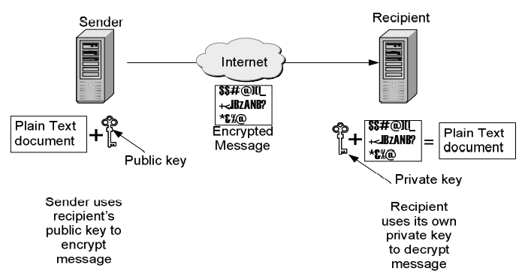
Asymmetric Encryption—In asymmetric encryption, different keys are used for encrypting and decrypting, such as a public and a private key

Slide 17
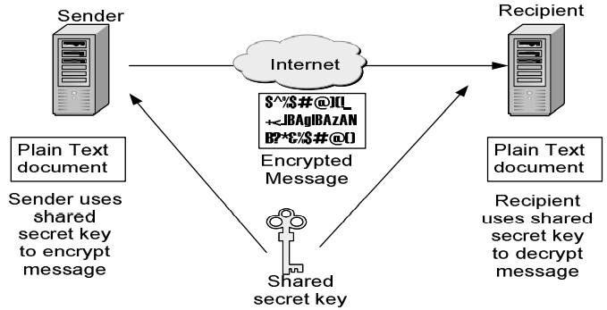
2. Symmetric Encryption: It can be used for at-rest and in-transit cloud data. It uses a shared secret key to encrypt as well as decrypt data.

Slide 18
Key Protection
The shared secret key can be a string of random letters, numbers, or a simple word. It is applied to the text to encrypt the content
The sender and the recipient are both aware of the key, they can quickly encrypt and decrypt documents and messages exchanged between them
The shared key can be protected by encrypting the key itself the shared key can be protected by encrypting the key itself using following steps;
The sender uses the recipient’s public key to encrypt the shared key
The encrypted shared key is sent to the recipient
The recipient uses its own private key to decrypt the key
The above process ensures that cloud users who get unauthorized access to the keys are not able to use the keys, because the keys are encrypted and can be decrypted only by the recipient

Slide 19
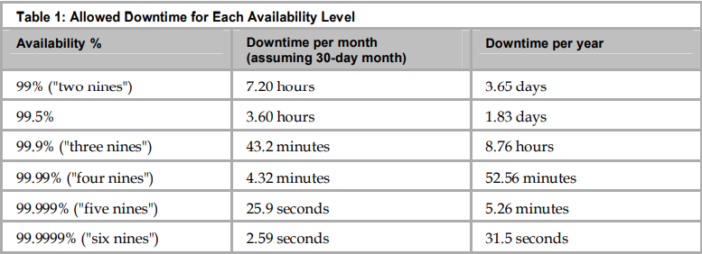
Data Availability
If the user keeps the data confidential and secure, it must also be available to them whenever they need it
SLAs with your cloud provider must have data uptime agreements
Data or service availability is expressed as a percentage of uptime in a given year or month
SLA with the cloud service provider must refer to monthly allowed downtime

Slide 20
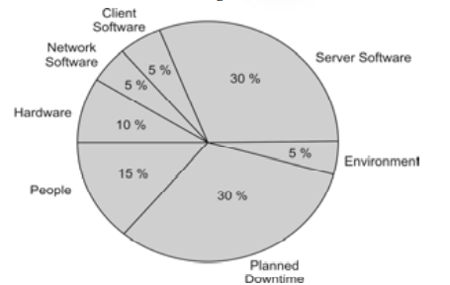
If the data in the cloud is not accessible, the services are down. Downtime has a soft and a hard cost, which are explained as follows:
Soft Cost—Loss in customer confidence and employee morale.
Hard Cost—Loss due to employee productivity and customer revenue during the outage window
Common reasons for service outages:

Slide 21
Data Integrity
The user needs to reactively detect if the data has been modified and prevent such occurrences from happening again
To detect if the data has been modified or tampered with, users need to have data origin authentication
Regular backups are important to reactively replace tampered data
There are many proactive measures that the cloud provider can take to ensure data integrity:
Must control the access to data using mechanisms such as RBAC (Role based Access Control)
Must design and implement user interfaces that prevent input of invalid data
Must use error detection and correction software when transmitting data within or outside the cloud

Slide 22
Cloud Storage Gateways (CSGs)
Important
To address the performance and security issues in public clouds, consumer organizations can use CSGs
CSG is a storage appliance, residing in the customers' premises and provides data protection by encrypting, compressing, and archiving data sets before moving the data to a cloud
It intercepts all the I/O between the customer datacenter and all the public clouds
A hardware appliance with a cache
A CSG could also be a downloadable software program that can be installed on a server at the customer location
CSGs eliminate the issue of vendor lock-in, because they support various formats and facilitate data backup
CSG vendor provides credentials for each cloud provider and call-home features

Slide 23
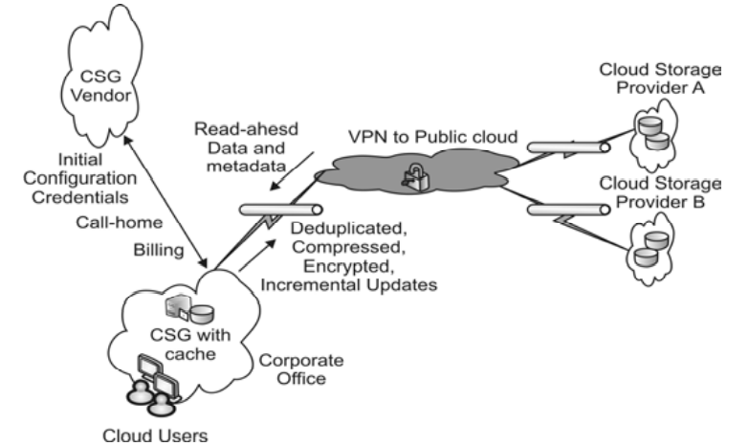
Important
Figure: CGS

Slide 24
The call-home features allow the CSG to automatically report issues, status, problems, and diagnostic reports to the CSG vendor to enable preventive maintenance or accelerate problem and resolution
The CSG provides data protection in 4 steps:
The CSG cache accelerates I/O rates and enables a convenient replication procedure
Files that are to-be-copied to the cloud are first stored in the CSG cache
After a certain pre-set time interval, the cache data is pushed to the cloud
Data that is read from the cloud is copied to the cache

Slide 25
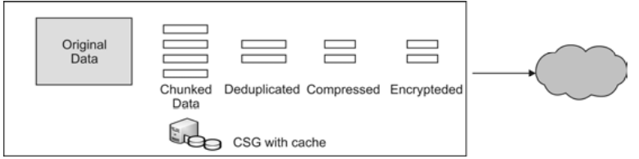
CSG must provide the following features or benefits:
Caching Algorithms: The cache in a CSG provides a buffer of vital data to speed access and reads, instead of having to reach out to the original servers to read data each time it is required
Intelligent Pre-fetching Algorithms: CSG must monitor read patterns and intelligently pre-fetch data from the cloud to the cache before the user requests the data
Caching Time Periods: Some CSGs allow users to setup a caching time duration
Synchronous Snapshots: CSG must take a synchronous snapshot of the user file tree and data. This is an instantaneous, sub-second picture of the customer’s file system at a particular instant
Data Replication Process: CSG must have an efficient data transfer mechanism. Ideally, it must split files into chunks

Slide 26
End-to-end Encryption: This protects data from being read by unauthorized users and hackers. The CSG must use strong data encryption for the content as well as the metadata
Secure Channels: the data in-transit between the CSG and the cloud is double encrypted; it is encrypted before it is transmitted and also when it is sent over a Virtual Private Network (VPN) tunnel to the cloud
Data Compression: It helps reduce bandwidth and storage space utilization
CSG Tuning Parameters: CSG must allow its administrator to tune certain parameters such as maximum bandwidth utilization during certain time periods and cache push intervals

Slide 27
Cloud Firewall
A cloud firewall is a network firewall appliance, explicitly built to work with other cloud-based security solutions
It serves the same purposes as traditional firewalls, but it is different from a traditional firewall on the following three aspects:
Scalability—Cloud firewalls are designed to scale as customer bandwidth increases, or at the least, any hardware upgrade has to be made transparent to customers.
Availability—Cloud firewall providers offer extremely high availability through an infrastructure with fully redundant power and network services, as well as backup strategies in the event of a site failure
Extensibility—Cloud firewalls are available in locations where the network manager can provide a protected communications path

Slide 28
Virtual Firewall
A VF is a network firewall service running entirely within a virtualized environment
Like a physical firewall, it provides the usual packet filtering and monitoring
Virtual firewalls provide an easy way to decrease investment expenses by consolidating multiple logical firewalls onto a single platform
Depending on the point of deployment, virtual firewalls can operate in two different modes namely, bridge mode and hypervisor mode
In bridge-mode, the firewall acts like a physical firewall that works with a physical or virtual switch to intercept network traffic destined for other network segments
In hypervisor mode, the firewall service resides in the virtualization hypervisor, where it can capture, monitor, and filter all the activities of all the virtual machines and logical resources

Slide 29
AAA Authentication, Authorization and Accounting
Important
The key data requirements in a cloud are confidentiality, integrity, and availability
The cloud providers and users must make sure that the login access is well protected
In the cloud, users have multiple ways to authenticate and check user identities
The login credentials must be encrypted with the Personally Identifiable Information (PII) for security

Slide 30
AAA Model
AAA (or triple-a) has traditionally proven to be a battle-tested model for user-access security
The login or security server first checks if the login name and password are legitimate- Authentication
It then decides the modules of the application or sets of data that he or she can use or view- Authorization
The server keeps a log or account of all the resources utilized and the user activities- Accounting

Slide 31
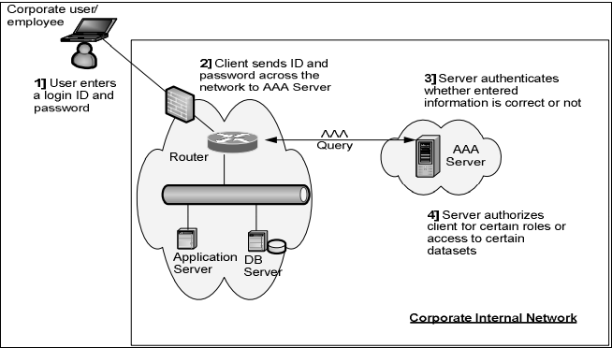
Fig. Authentication & Authorization by AAA server

Slide 32
SSO for cloud (Authentication)
Single Sign-on enables users to access multiple systems or applications after signing in only once
When user signs in, the user identity is recognized and there is no need to sign in again and again to access
Mechanisms for SSO:
SAML token
Kreberos
OTP

Slide 33
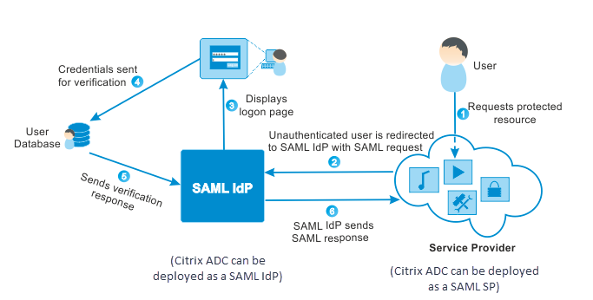
SAML
Security Assertion Markup Language is XML-based open standard data format for exchanging security information
When user tries to access cloud application, a SAML request is generated and user is redirected to the identity provider
SP parses the SAML request and authenticate user on cloud

Slide 34
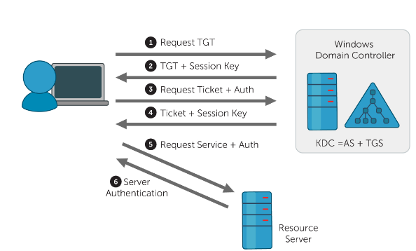
Kerberos
It is open authentication protocol
Uses tickets for authenticating client to a service that communicate over an un-secure network
Provides authentication for both client and server

Slide 35
Client authenticates itself to Authentication server on KDC (Key distribution center). Sends client ID and remote service to access
AS checks if client is on database and generates TGS session key. That will be used by client and remote service for communication. Session key further encrypted with user password.
KDC generates ticket i.e. TGT (Ticket granting ticket) includes client id, client network address, ticket validity period and session key. Encrypt this ticket with secret TGS key
Further, KDC sends encrypted session key and TGT to client
Client decrypt and uses session key
Client encrypts client ID and current time using session key to prepare authenticator and sends it to TGS along with TGT
TGS decrypts TGT using secret key and retrieves session key. TGS then decrypts the authenticator using session key and uses client ID and time.
TGS then sends two piece of data to client- Service secret key and session key
After receiving client server ticket and session key from TGS, the client has enough information to authenticate itself to remote services

Slide 36
When client wants to communicate with remote services,
Client sends two piece of data- (i) Client-server ticket encrypted with service’s secret key and (ii) New authenticator includes client id, timestamp and encrypted session key
Remote service decrypts client-server key and authenticator to get session key
It responds with timestamp found in client’s authenticator plus 1, encrypted using session key
Client will decrypt the message using session key and confirms timestamp

Slide 37
One Time Password (OTP)
It is authentication mechanism
Uses OTM tokens are useful to prevent replay attacks
Text messaging is most commonly used communication for OTP
Time based OTP generation is a popular synchronization based algorithm

Slide 38
Authorization Management in clouds
Authorization refers to specifying the access rights to the protected res0urces using access policies.
OAuth:
Open standard for authorization that allows resource owners to share their private resources stored on one site with another site
OAuth 1.0 protocol was published in 2010 and OAuth 2.0 framework was published in 2012
In OAuth model, an application requests access to resources controlled by the resource owner
The resource owner grants permission to access the resources in the form of a token and matching shared-secret
Token does not share credentials for resources. Tokens can be granted with a restricted scope and limited lifetime

Slide 39
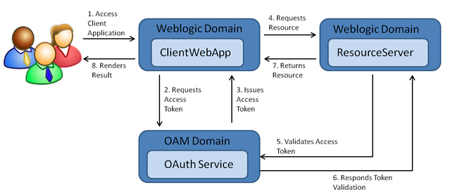
Figure. OAuth Authorization flow

Slide 40
Accounting for Clouds Resource Utilization
Accounting for cloud is the amount of all resources utilized by a user or an organization within a specific time period
Accounting does not allow or deny anything
The utilization should include:
Amount of time the user is logged in and actively using the applications
Hardware resources used such as processing power, memory, and storage space
Amount of data transferred, which can be data that is moved into the cloud, out of the cloud, or between two storage devices within the cloud
The billing rates could be different, based on the origin and destination of the data transfer

Slide 41
Cloud service providers must have a way consumers can review their daily or weekly utilization or in real-time to forecast the bill
There must be a way for a trusted third party to evaluate and verify the resource utilization and billing
The administrator must be able to set quotas (maximum allowed utilization) for each user, application, or resource
Payment per billing period must be based on the following:
Reserved Resources—The user or customer may reserve storage space, CPU, and memory for its use
Utilized Resources—The billing for bandwidth and application time would be based on actual utilization by the customer

Slide 42
Accounting keeps a log of resource consumption such as the following:
Identity of the user
Amount of resource used
Start and end time of use Chapter
Amount of data transferred
Length of connection
Purpose of using the resource
Nature of service delivered
Following are the two types of accounting reports:
Real Time Accounting Information: Useful for cloud users to track usage and predict the bill, expected at the end of the payment cycle
Batch Accounting Information: Useful for cloud service providers for billing at the end of each payment cycle. The data is also used for studying utilization trends and capacity planning

